Slide 1


Introduction to Software Development
Week 3 Day 3
Led by: Emily Crose
for
Oakland University

Slide 2
Last Session Recap

Slide 3

Questions From Last Session?

Slide 4
Terms To Listen For
Versioning
When we make changes to our codebase
Change Management
Our approach to making and documenting changes
“Prod”
In production network
“Dev”
Development network/branch

Slide 5
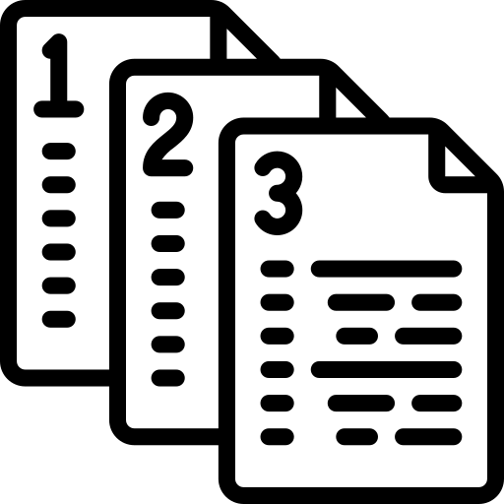
Versioning
Notes:
So we’ve talked about how we develop software, but what we haven’t addressed yet is one very important piece of this process – versioning.

Slide 6
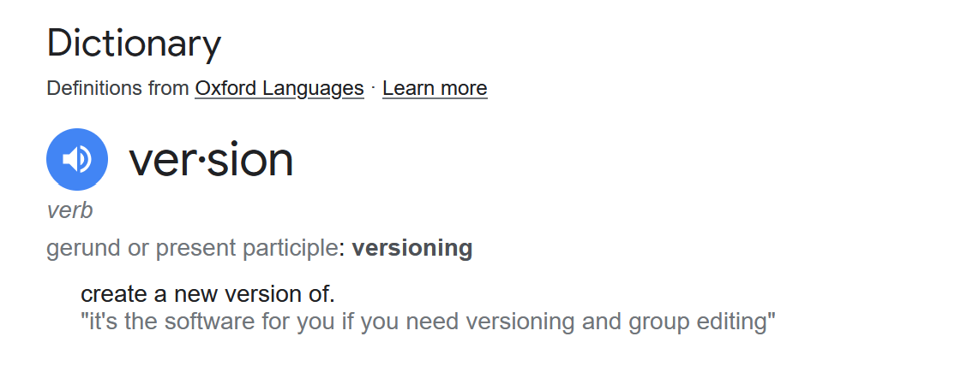
Versioning: Definition
Notes:
Here’s a definition for the term versioning. In other words, we’re creating a new version of something, for example a new version of our code.

Slide 7
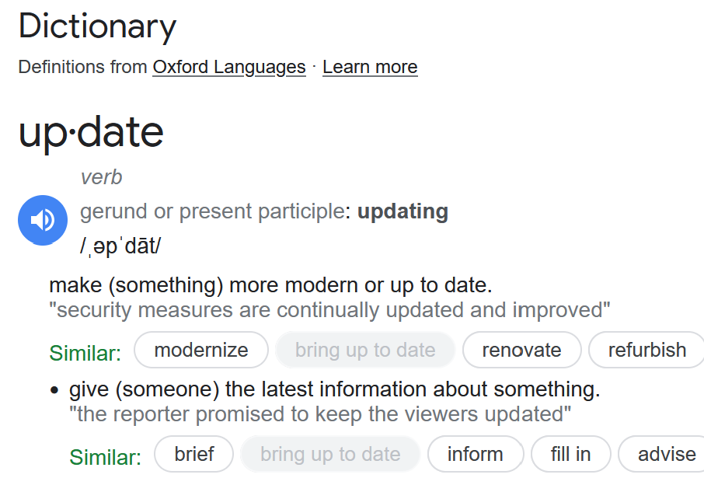
Updating Definition

Slide 8

Question: Is Versioning The Same As Updating?
Notes:
So let’s ask this question first, is versioning the same thing as updating? Why or why not?

Slide 9

Emily’s Answer:
No, updating is different from versioning.
Why?
Notes:
Ok, so updating is different from versioning, but why?

Slide 10
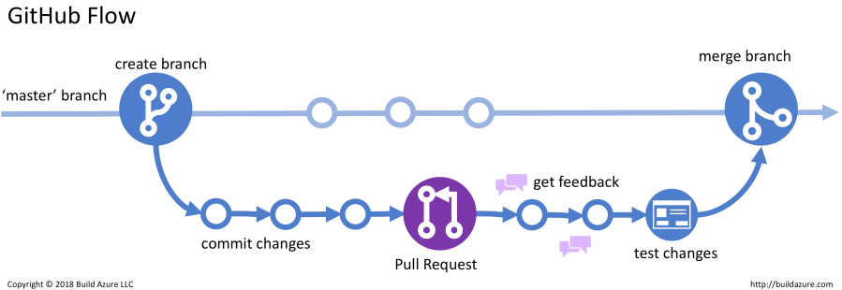
Versioning At-A-Glance
Notes:
This is a diagram showing my definition of “versioning”. We could use the term “updating” more freely in the context of updating a repository, but generally when we use the term “updating” we’re talking about pushing the code out to our userbase.
So why is this difference notable? Because we will be changing our code all.the.time.
What we see on this slide is a diagram of branches and staged updates. If we imagine the main branch as a timeline of code moving through time, we will the original code, and all of the changes in versioning to that code that made it what it is today. Now that we’ve taken a look at this briefly, let’s put a pin in this and come back to it when we revisit these concepts during our two days of github next week.

Slide 11


Change Management
Notes:
This process of making changes is what we call “change management”. In yesterday’s session, we talked about the fact that we don’t build static code anymore, generally speaking. So because we’ve committed to producing code, we also need to commit to changing that code, and changing that code frequently. This frequent state of change necessitates a methodical approach to managing those changes.

Slide 12

Virtualization & Sandboxing
Notes:
Let’s make a hard change over now and talk about virtualization. Virtualization may also be called “sandboxing”

Slide 13

Virtualization, what is it?
Virtualization is an isolated Run Time Environment (RTE)
Easily replaceable
Highly customizable

Slide 14
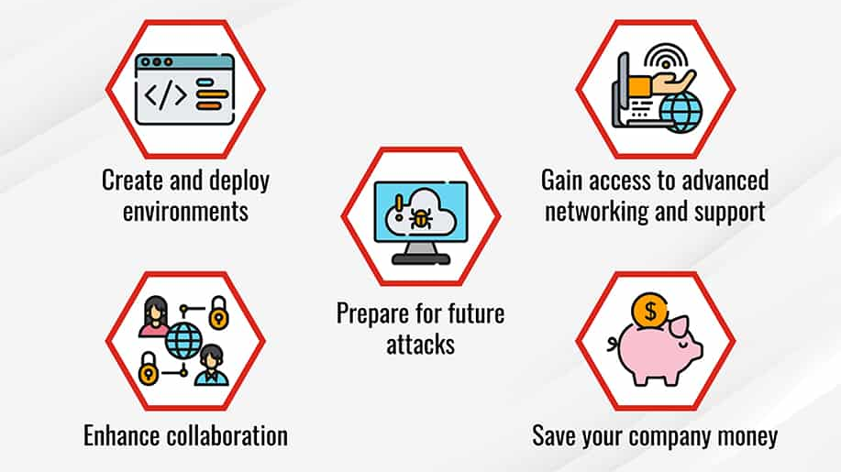
Why Virtualize?

Slide 15

Where Can We Use Them?
In programming:
Virtual ENV
In Testing
Vagrant
In Deployment
Docker
Kubernetes

Slide 16

Vagrant
Ideally Used:
As endpoint development hosts (vs. server-based)
Benefits:
Can be used to distribute copies of the same environment
Somewhat easy to automate deployment/setup

Slide 17
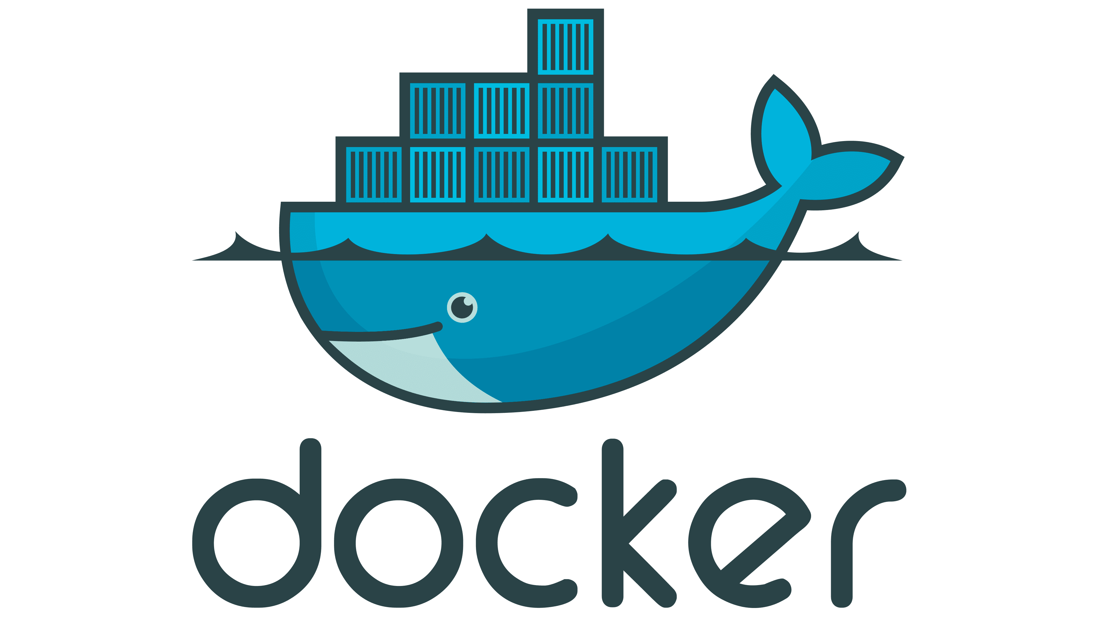
Docker
Ideal use:
Isolated services
Benefits:
Highly customizable/configurable
Can be deployed either persistent or as a single instance

Slide 18

Kubernetes
Ideal use:
Server images/clusters
Benefits:
Operates as an appliance
Alternative to Docker
Better for scaling

Slide 19

Tips For Virtualizing
Take the time to carefully plan virtualization environments
Apply SDLC elements to building these environments?
These may be deployed in production!

Slide 20

Understanding Environments
Environments:
Production
Redundant Production
Testing

Slide 21
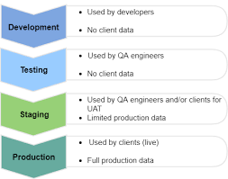
Environments Cont’

Slide 22
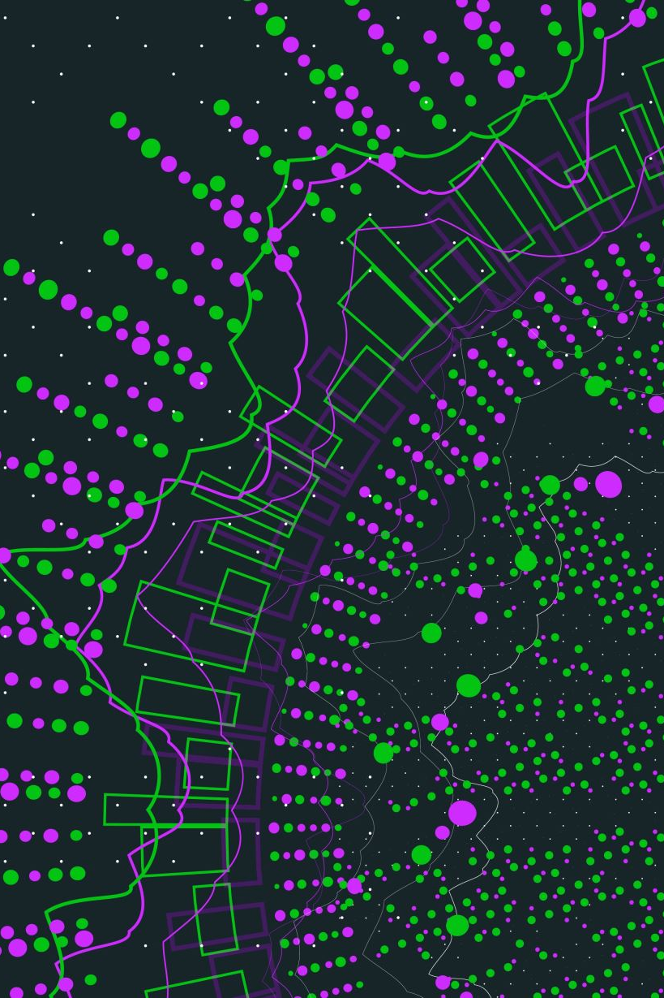
What Is Prod?

Slide 23

Why Not Just Push To Prod?
Notes:
Why might it be a bad idea to push code directly to our production network?

Slide 24
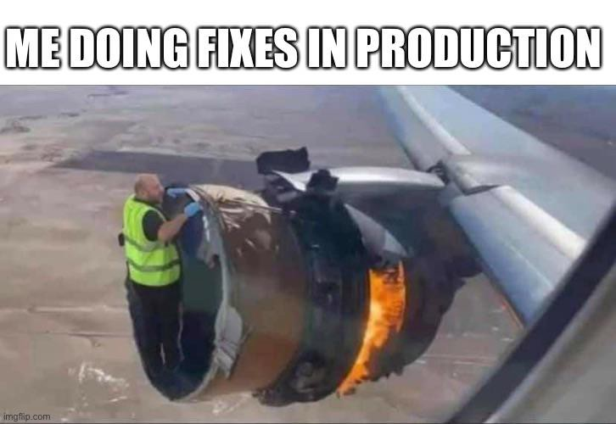
This Is An Option Of Last Resort

Slide 25

Testing & Deployment
Notes:
When we’re done testing our code, we will begin to move our code out of testing environments and into deployment environments, so what does that look like exactly?

Slide 26

10 minute break

Slide 27

Launch & Revert

Slide 28
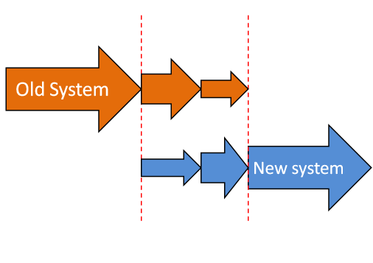
Phased Deployment
Notes:
Phased deployment is a particularly helpful approach we can take for replacing an aging system. Although this comes in very handy for situations where we need to sunset an existing system or service, we can still take a phased approach to other parts of the SDLC such as code deployment even if we aren’t replacing network components wholesale.

Slide 29
Example
Internal group A
Internal group B
External group A
External group B
External group C

Slide 30
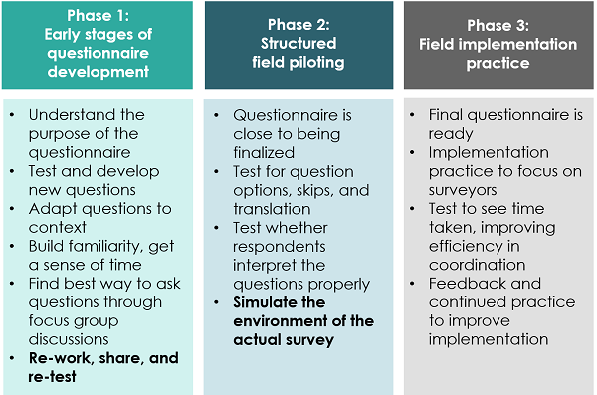
Pilot Testing

Slide 31

Building A Good Pilot Group

Slide 32

Eating Our Own Dogfood

Slide 33

Deployment Monitoring
Notes:
We can use deployment monitoring to identify problems with our code.

Slide 34

What Do We Want To Monitor?
Logs
System stability
Endpoint stability
Telemetry
Has there been an interruption in expected incoming data?

Slide 35

Monitoring Software Options

Slide 36
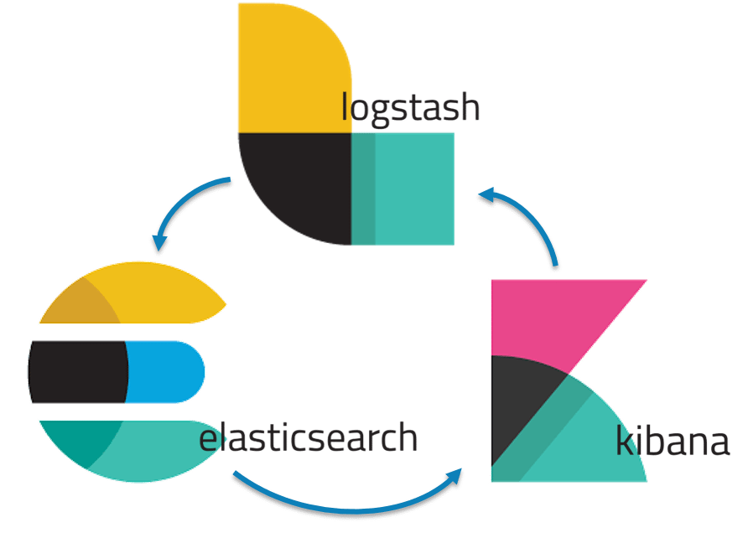
ELK

Slide 37

Grafana

Slide 38
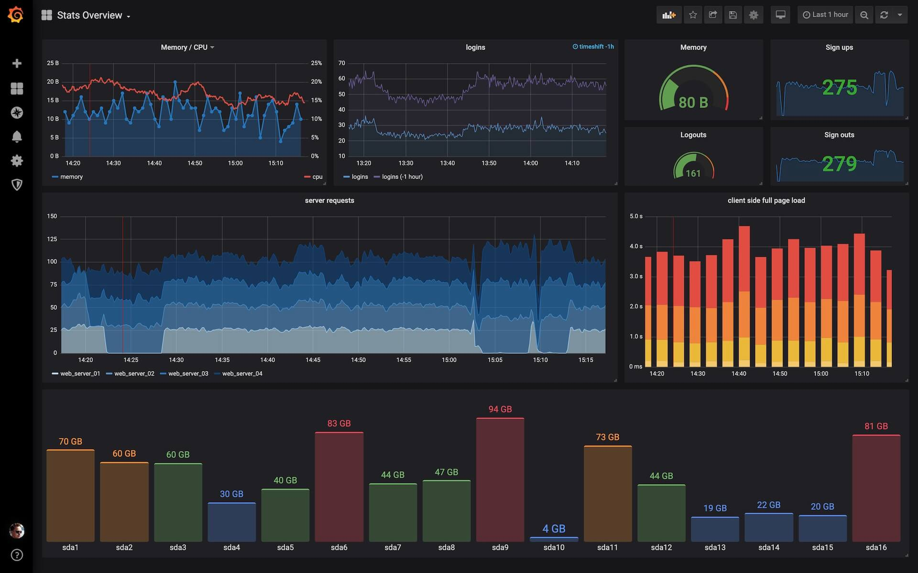

Slide 39
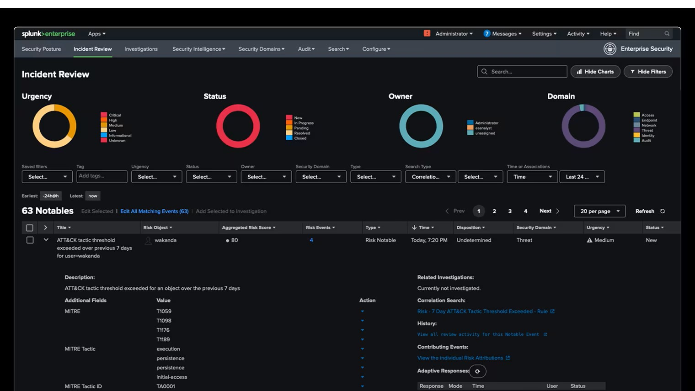
Splunk
Notes:
Splunk is optimized for security, but it is also a log aggregation and search tool, so it can be used for monitoring. The thing to keep in mind with Splunk is that it’s fairly expensive when dealing because the way they license this software is by how much data is being processed. So as your data set grows, so does your bill.

Slide 40
Knowing When To Revert

Slide 41
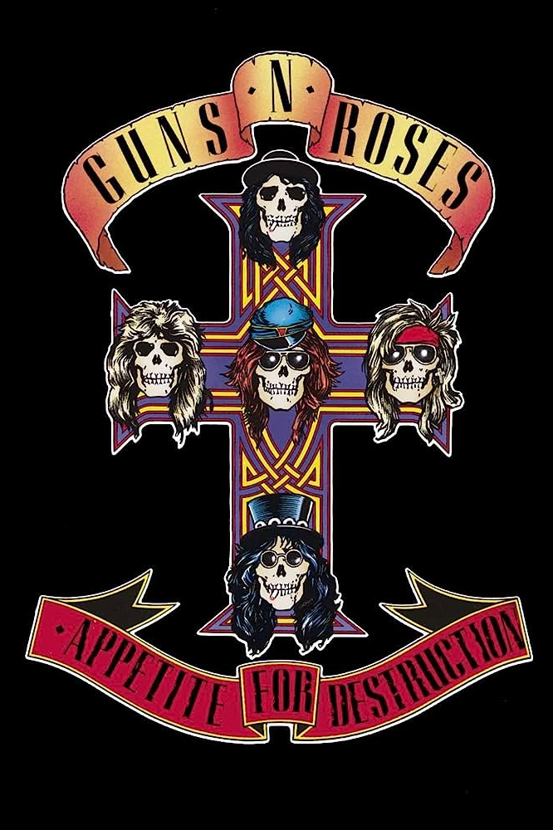
Notes:
The answer to this question depends at least in part on what your appetite for destruction is. When deciding when to revert an update, consider the severity of the issues you’ve identified. How critical are they? Are we crashing mobile devices? Is our app not loading at all? Did we accidentally overload our back-end with a faulty process?
Or is the issue something minor that our users probably won’t even notice? What even is the ballpark number of users who are effected by the issue?
In any case, we will let the evidence guide this decision making. Are we seeing logs that may indicate that a problem needs to be addressed?

Slide 42

Practical Deployment Tips
Plan code deployment thoroughly!
Avoid pushing updates on Fridays and at the end of the month
Avoid pushing updates just before major holidays
Assign a point-person for deployment
Diversify your point person from release-to-release
Notes:
Here are a few tips you can use when you go to deploy new code. These are bits of wisdom I have picked up after going through this process many times myself.
On diversifying our point-person from release-to-release, we want to strive for having as many redundancies for our team to fall back on as possible. In the case of deployment, we should make sure that we have at least 3 people on our team who have been given both the training and the permissions to do a deployment independent of any other members of the team.

Slide 43

Regular Expressions
Notes:
One thing we can use to zoom in on data in many of these monitoring tools is an extensible language called “regex”

Slide 44
What Is Regex?
Our way of parsing large volumes of data
Strings-based method of searching
Matches patterns rather than exact literal character strings

Slide 45
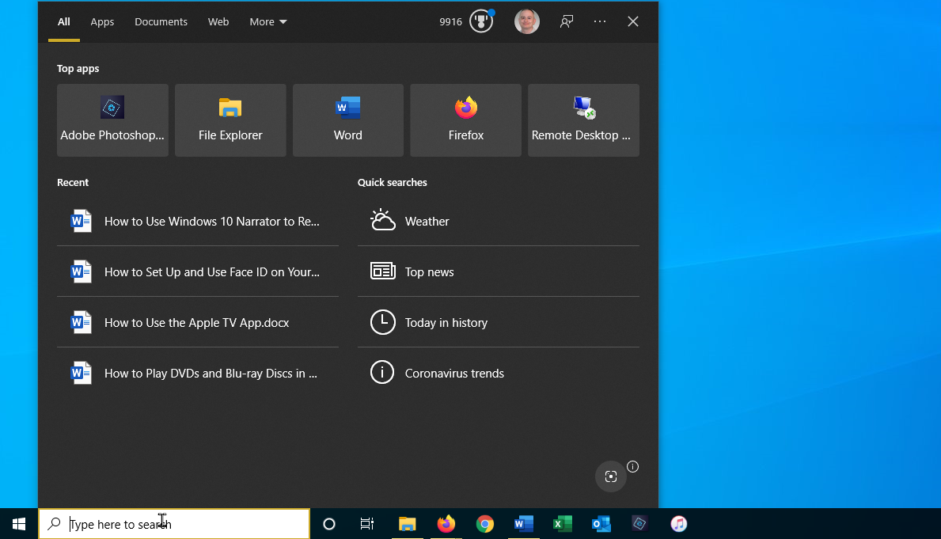
How We’re Used To Searching

Slide 46
So What?

Slide 47
Problems Regex Solves
What if we want to find information we don’t know exists?
What if we want to collect all of the information in a log with one specific feature?
Emails?
IP addresses?
Telephone numbers?
What if we only have a pattern we recognize, but not a full list of filenames?

Slide 48
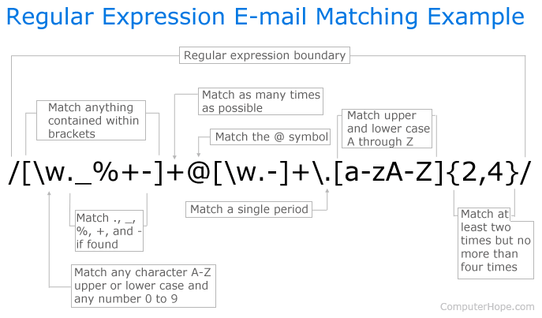
Regex Example

Slide 49
Try Regex Yourself!
https://regexr.com/
https://www.regextester.com
https://regex101.com/
Notes:
What we’ll do now is hand an integrated regex practical combined with our 10 minute break. So for the next 15 minutes, choose one of these regex tools and give regex a try. There are some pre-built expressions you can use in each of these to see if you can match the strings. Knowing regex and practicing with it is a skill you’ll use all throughout the practical side of software development and it will make finding important information significantly easier if you are an effective regex user.
So you’ll have 30 minutes now to tinker with one or more of these regex tools, and when we come back, we’ll discuss what you thought of it!

Slide 50
10 minute break

Slide 51

How Do We Apply The SDLC As Managers?
Notes:
Over the last two days, we talked at length about the SDLC as a broad concept, and we introduced the devops lifecycle as well as a way of understanding a technically applicable approach to the SDLC. But we’re not exclusively interested in the SDLC and devops from a purely technical perspective. We’re also interested in this concept from the management perspective as well.

Slide 52
Finer Points of SDLC Application
Notes:
These discussions about how to apply the SDLC from a technical standpoint have been leading up to a higher-level discussion about how we as managers can apply and direct the various steps within the SDLC to get our desired software development outcomes.

Slide 53

Advice: Be Flexible!
Notes:
I know it’s a bit cliché, but as managers, we should stay as flexible as possible so that we can respond to a changing environment. Coding is a dynamic landscape. It can be frustrating or even downright stressful, but the more flexible we are, the easier it will be for us to use the tools we have in the SDLC to solve the problems we have before us.

Slide 54

Use Our Tools
Notes:
We should see the steps within the SDLC as tools as much as they are steps in a larger lifecycle. What do I mean by that?

Slide 55
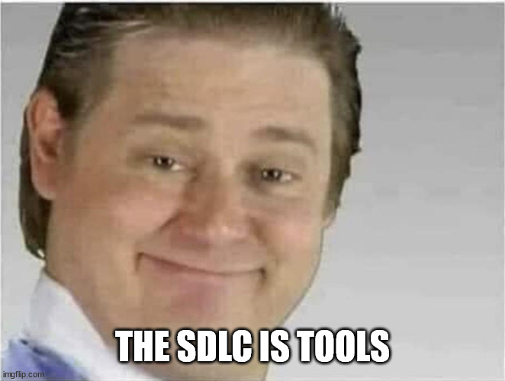
Here’s A Secret:
The SDLC can be done out of order
(Within reason, of course)
Notes:
Here’s a big secret: the SDLC can be done out of order! Within reason, of course. We can

Slide 56
Agile
Waterfall
Lean
Notes:
For example, if we wanted to optimize our SDLC workflow for flexibility, we can use Agile. If we are less flexible and we like a perfectly orderly approach to the tasks we need to do for the SDLC, we may use Waterall. This will mean that our And if that works for you, then great! If you can swing it, then Waterfall is great. Keeping things perfectly linear helps keep things perfectly organized.

Slide 57

Emily’s Opinion Moment
Notes:
But here’s the thing…Waterfall only works in the unlikely situation when you can control for all development needs and ever-changing variables

Slide 58
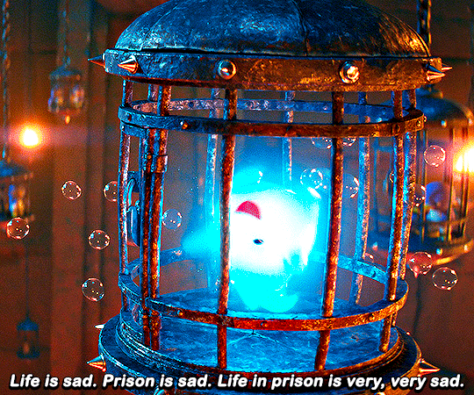
Reality
Notes:
The reality is that we don’t live in a perfect world, and in our imperfect world, we need to roll with the punches. It would be awesome if all my team ever had to do was create new content and features every day. Oh my god, I can’t even imagine how nice that would be. But we have all types of things that need to be done from day-to-day that will make that goal challenging.

Slide 59
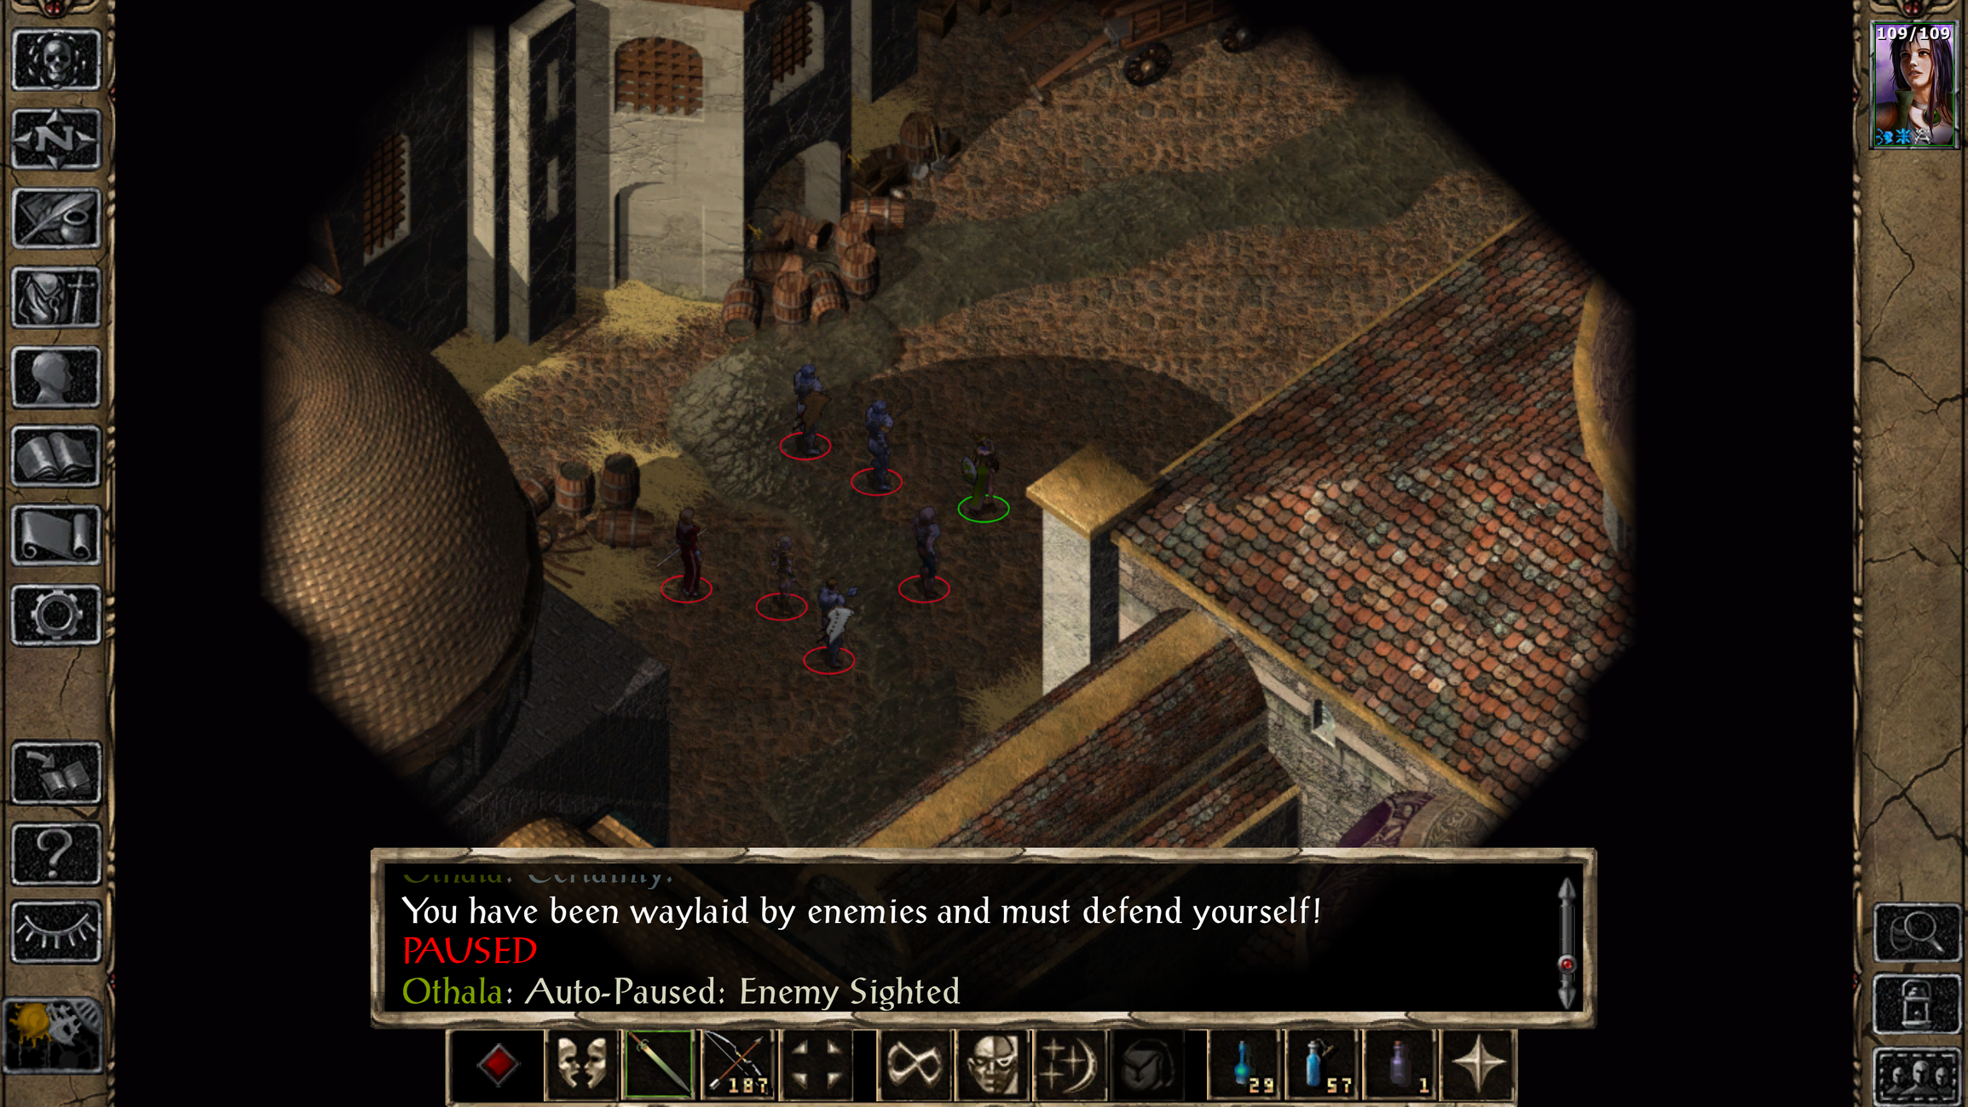
Bug tickets
Urgent fixes
Client requests
MEETINGS
Research
Systems re-engineering
MORE MEETINGS

Slide 60

Dealing With Customer Needs

Slide 61
Bug Prioritization

Slide 62

New Feature Development

Slide 63

Balancing Features With Fixes

Slide 64

Question or clarifications?

Slide 65

Review

